Slide 1

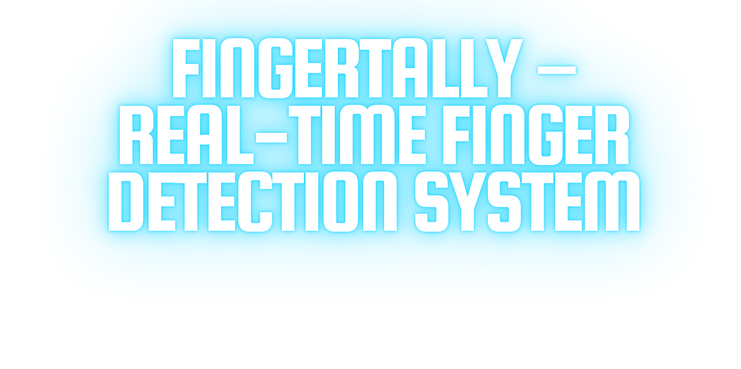

HAND TRACKING & FINGER COUNTING USING OPENCV & MEDIAPIPE
BY - MONICA

Slide 2
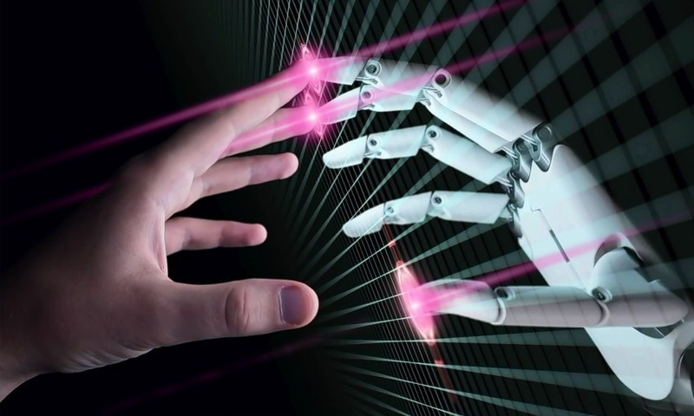
WHAT IS FINGERTALLY?
A computer vision-based system that detects hands and counts extended fingers. Uses OpenCV and MediaPipe for real- time hand tracking.
WHY FINGERTALLY?
Enables gesture-based input. Useful for interactive applications and education.

Slide 3

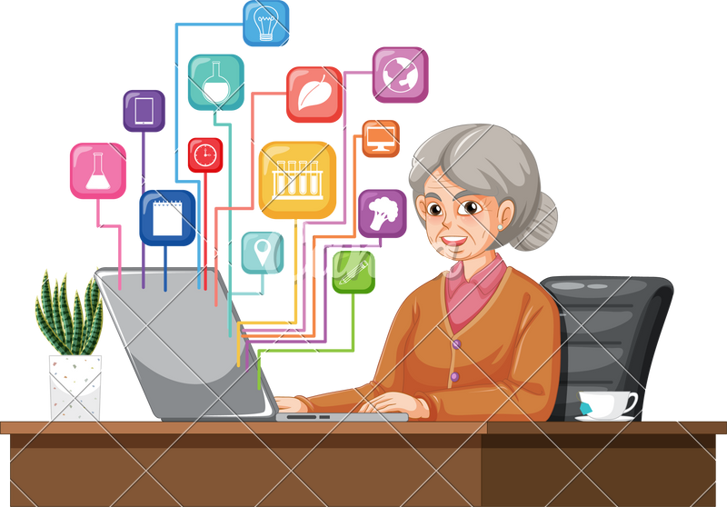
TECHNOLOGIES USED
Programming Language: Python
1
Libraries:
2
OpenCV (cv2) –Image processing
& video handling
MediaPipe – Pre-trained hand
tracking solution
3

Slide 4
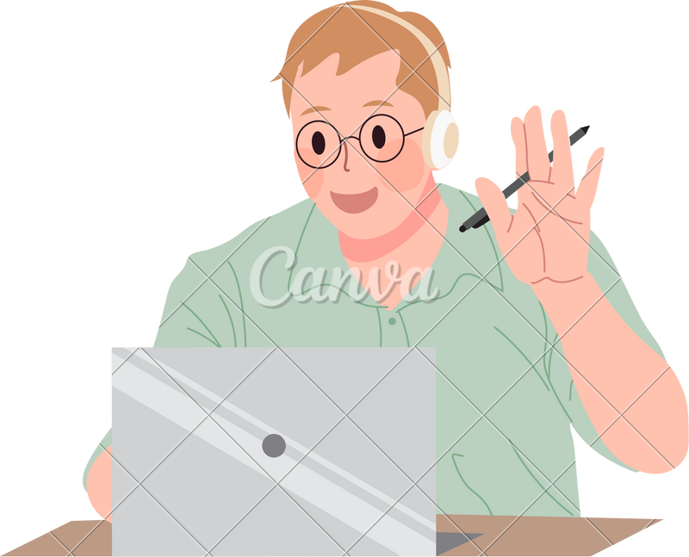

WORKING PRINCIPLE
Captures real-time video from the webcam. Detects hand landmarks using MediaPipe Hands. Identifies extended fingers based on landmark positions. Determines left or right hand using key points. Displays finger count and whether it is odd or even.

Slide 5
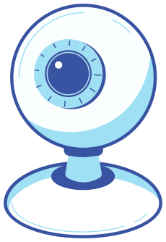
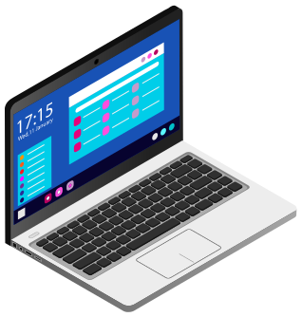
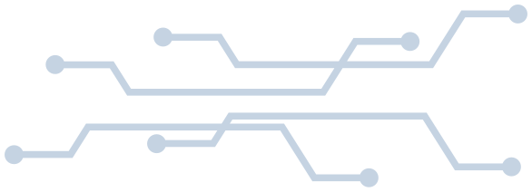
SYSTEM ARCHITECTURE
1.WEBCAM CAPTURES VIDEO
2.CONVERT IMAGE TO RGB (REQUIRED BY MEDIAPIPE) 3.HAND DETECTION USING PRE-TRAINED MODEL 4.EXTRACT LANDMARK POSITIONS 5.FINGER COUNTING ALGORITHM 6.DISPLAY RESULTS ON SCREEN

Slide 6
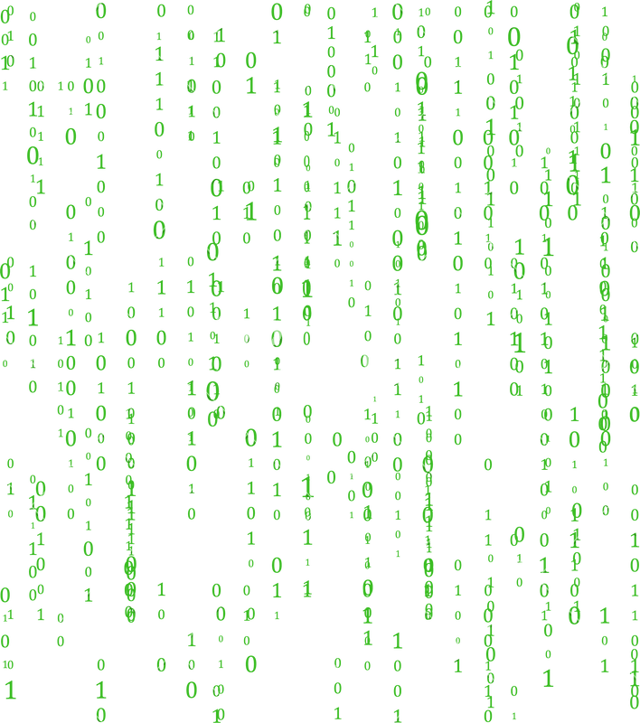

CODE EXPLANATION (BASIC)
Hand Detection: Uses MediaPipe's pre- trained model.
Finger Counting Logic:
Checks if fingertip y-coordinate is above its base MCP joint. If true, the finger is extended.
Text Display on Screen:
Hand Side: Left or Right Finger Count & Odd/Even Check

Slide 7

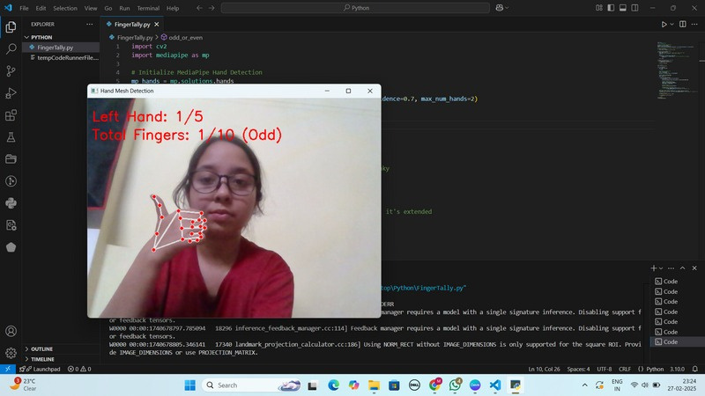
DEMO & OUTPUT
Red-Colored Text Display for better visibility
Live Video Feed with
Detected Hand Mesh
Hand side Detection
(Left/Right)
Finger Count and Odd/Even Check

Slide 8
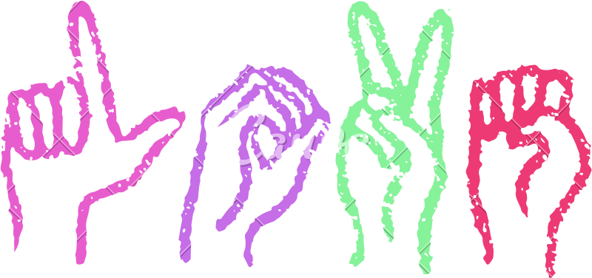
APPLICATIONS
Gesture-Based Input – Can be used for simple controls
.
Educational Tool – Learning numbers & hand gestures
.
Interactive Games – Motion-based interactions.
Sign Language Recognition (Future Possibility)

Slide 9

FUTURE ENHANCEMENTS
Recognizing hand gestures for more interaction.
Improving accuracy for various hand orientations
.
Supporting multi-hand gestures.
Extending to mobile apps using TensorFlow Lite.

Slide 10
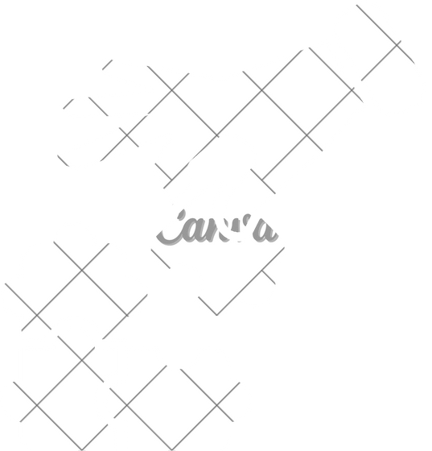
CONCLUSION
FingerTally is a computer vision-based real-time finger detection system.
Uses MediaPipe & OpenCV for fast and efficient tracking.
Open for gesture control & sign language enhancements.

